Slide 1






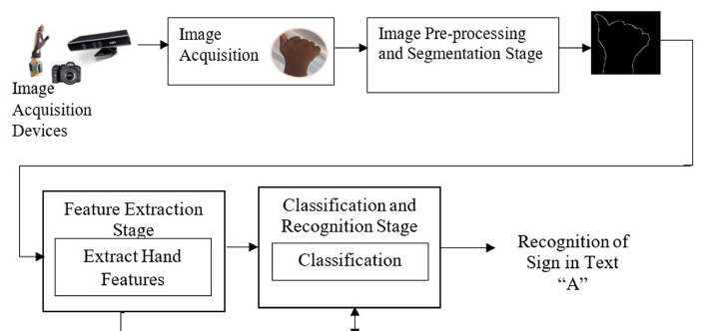





response
request
Voice Input
Input
Text Input
output
Sign To Text
Text to Sign
Speech recognition
Speech To Text
Video generation

Slide 2










Frontend
Response
API
Voice Input
Request
Text Input
Backend
Sign to Text & Voice
Text & Voice to Sign
Speech recognition
Speech to Text
Machine Learning Processing
Generated Video
Translate Output in English and French
Create
sentence
Transform to Speech

